Slide 1
Randomization inference for a chain of randomizations
Chris Brien
Phenomics & Bioinformatics Research Centre, University of South Australia.
The Australian Centre for Plant Functional Genomics, University of Adelaide.
This work was supported by the Australian Research Council.

Slide 2
Randomization inference: outline
A little history
Randomization by permutation of units
Randomization model for a single randomization.
Randomization model for a chain of randomizations.
Randomization analysis for a chain of randomizations.
Unit-treatment additivity.
Conclusions.

Slide 3
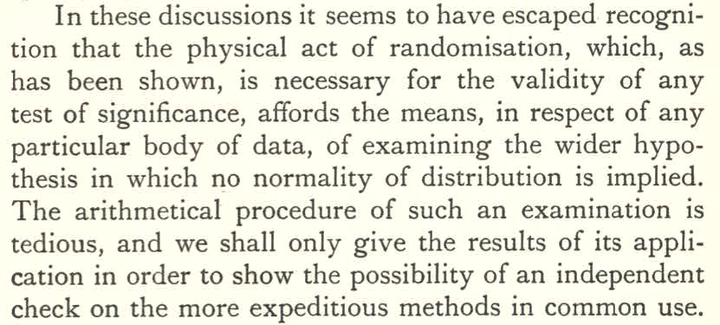
1. A little history
Fisher (1935, Section 21) first proposed randomization tests:
Different to a permutation test: based on the randomization employed in the experiment.

Slide 4
What role: check on normal theory tests?
What should one do if the check fails?

Slide 5
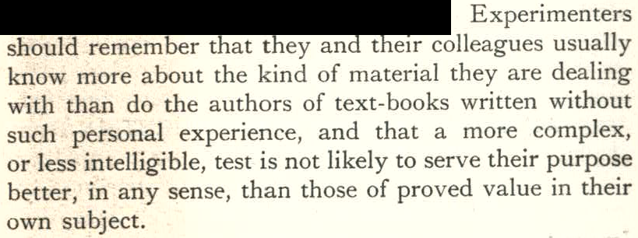
Fisher (1960, 7th edition) added Section 21.1 that includes:
Less intelligible test  nonparametric test.
He is emphasizing that one should model using subject-matter knowledge.

Slide 6
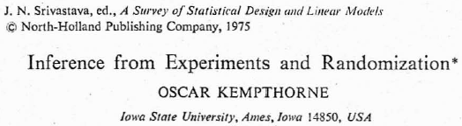

The only way?
The Iowa school: Kempthorne, Wilk, Zyskind, Throckmorton, White (50s - 70s)

Slide 7
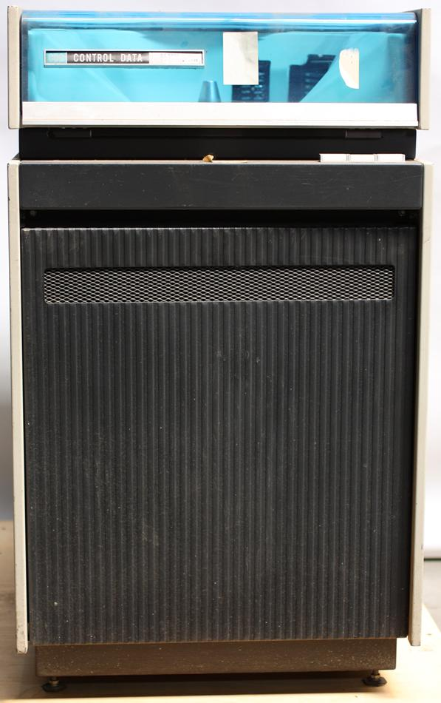
Back in 1971 …
Fresh from my final exams for a B Sc Agr, I arrived in Adelaide to take up a position as a consulting Biometrician.
First task: learn Genstat on a CDC 3200 (32K).
Lead to Nelder (1965a,b) and papers
by Adelaidians Wilkinson & James.
By 1973, I had realized that, to describe
evaluations of wine from field experiments,
needed more than block and treatment
factors (à la Fisher, Wilk & Kempthorne,
Nelder, Cox, Yates, White, Mead & Curnow).
An important aspect of Nelder’s papers
is the null randomization distribution,
on which inference could be based.
  an elegant alternative to the Iowa school.
Notes:
We’re talking on a CDC 3200 with card reader

Slide 8
Fast-forward to 2006
Brien and Bailey (2006) Multiple randomizations
In the discussion , Cox, Hinkelmann and Gilmour pointed out:
  no one had so far indicated how a model for a multitiered experiment might be justified by the randomizations.
Rosemary Bailey and I have advocated the use of randomization-based (mixed) models to analyse experiments with multiple randomizations:
  randomization justifies 2nd moment properties
  Bailey and Brien (2013) details estimation & testing.
Now, extend randomization inference to such experiments,
  using Nelder’s (1965a) approach for single randomization.

Slide 9
Randomization analysis: what is it?
A randomization model is formulated.
  It specifies the distribution of the response over all randomized layouts possible for the design.
Estimation and hypothesis testing based on this distribution.
  Will focus on hypothesis testing.
A test statistic is identified.
The value of the test statistic is computed from the data for:
  all possible randomized layouts, or a random sample (with replacement) of them;
  ⇒ randomization distribution of the test statistic, or an estimate;
  the randomized layout used in the experiment: the observed test statistic.
The p-value is the proportion of all possible values that are as, or more, extreme than the observed test statistic.

Slide 10
2. Randomization by permutation of units & unit factors
Permutations for an RCBD with b = 2, k = v = 2.
The allowable permutations are:
  those that permute the blocks as a whole, and
  those that permute the units within a block;
  there are b!(k!)^{b} = 2!(2!)² = 8.
 |  |  |  |  | Permuted
unit | Blocks | Units | Treatments | Permutation | Blocks | Units
11 | 1 | 1 | 1 | 4 | 2 | 2
12 | 1 | 2 | 2 | 3 | 2 | 1
21 | 2 | 1 | 1 | 1 | 1 | 1
22 | 2 | 2 | 2 | 2 | 1 | 2
Unit | Blocks | Units | Treatments | Permutation
1 | 1 | 1 | 1 | 4
2 | 1 | 2 | 2 | 3
3 | 2 | 1 | 1 | 1
4 | 2 | 2 | 2 | 2
Unit | Blocks | Units | Treatments
1 | 1 | 1 | 1
2 | 1 | 2 | 2
3 | 2 | 1 | 1
4 | 2 | 2 | 2
Equivalent to Treatments randomization 1, 2, 2, 1 to units 11, 12, 21,22.

Slide 11
3. Randomization model for a single randomization
Additive model of constants:
y = w + X_{h}τ
  where y is the m-vector of observed responses for each unit υ;
  w is the m-vector of constants representing the contributions of each unit to the response; and
  τ is a t-vector of treatment constants;
  X_{h} is m×t design matrix giving the assignment of treatments to units.
Under randomization, i.e. over all allowable unit permutations applied to w, each element of w becomes a random variable, as does each element of y.
  Let W and Y be the m-vectors of random variables and so we have
Y = W + X_{h}τ.
  The set of Y_{υ} forms the multivariate randomization distribution, our randomization model.
  Now, we assume E_{R}[W] = 0 and so E_{R}[Y] = X_{h}τ .
Notes:
Unit upsilon

Slide 12
Randomization model (cont’d)
Further,
  H is the set of generalized factors (terms) derived from a poset of factors on the units;
  ζ_{H} is the covariance between variables with the same levels of generalized factor H;
  ψ_{H} is the canonical component of excess covariance for H;
  η_{H} is the spectral component (eigenvalue) of V_{R} for H and is its contribution to E[MSq];
  B_{H}, S_{H}, and Q_{H} are known m×m matrices.
This model has the same terms as a randomization-based mixed model (Brien & Bailey, 2006; Brien & Demétrio, 2009; Bailey & Brien, 2013):
  however, the distributions differ.
Notes:
Zeta = covariance, psi = canonical components, and eta = spectral component.
Spectral component = eigenvalue
B are known incidence matrices, S are know summation/relation matrices and Q are known projection matrices.

Slide 13
Randomization distribution: RCBD
This distribution obtained by applying each unit permutation to w:
Permutation | Y11 | Y12 | Y21 | Y22
1 | w11 + τ₁ | w12 + τ₂ | w21 + τ₂ | w22 + τ₁
2 | w12 + τ₁ | w11 + τ₂ | w21 + τ₂ | w22 + τ₁
3 | w11 + τ₁ | w12 + τ₂ | w22 + τ₂ | w21 + τ₁
4 | w12 + τ₁ | w11 + τ₂ | w22 + τ₂ | w21 + τ₁
5 | w21 + τ₁ | w22 + τ₂ | w11 + τ₂ | w12 + τ₁
6 | w21 + τ₁ | w22 + τ₂ | w12 + τ₂ | w11 + τ₁
7 | w22 + τ₁ | w21 + τ₂ | w11 + τ₂ | w12 + τ₁
8 | w22 + τ₁ | w21 + τ₂ | w12 + τ₂ | w11 + τ₁
Y_{ij} for Unit j in Block i.
However, w is unknown and so the distribution is not observable.

Slide 14
Null randomization distribution
  Anscombe (1948) and Nelder (1965a) originated the concept — not widely known.
Null randomization distribution is based on the model in which no treatment effects are assumed , i.e.
Y^{N} = W + μ^{n}1.
Under this model,

Slide 15
V^{N}_{R} for the RCBD example
The matrices in the expressions for are known.
where

Slide 16
Population parameters of RCBD
(regarding the observed values as the population)
Mean and variance straightforward:
σ_{B} is the covariance between observations in the same block.
σ₀ is the covariance between observations in different blocks.

Slide 17
Obtaining the null randomization distribution
Under the null model, permuting the elements of w and y are equivalent.
  Suppose, for a permutation of w, unit υ₁ is to receive unit υ₂:
  Actual distribution obtained by applying each unit permutation to y.
Permutation | Y^{N}11 | Y^{N}12 | Y^{N}21 | Y^{N}22
1 | y11 | y12 | y21 | y22
2 | y12 | y11 | y21 | y22
3 | y11 | y12 | y22 | y21
4 | y12 | y11 | y22 | y21
5 | y21 | y22 | y11 | y12
6 | y21 | y22 | y12 | y11
7 | y22 | y21 | y11 | y12
8 | y22 | y21 | y12 | y11
Y^{N}_{ij} for Unit j in Block i.

Slide 18
Distibution’s parameter values: RCBD
Permutation | Y^{N}11 | Y^{N}12 | Y^{N}21 | Y^{N}22
1 | y11 | y12 | y21 | y22
2 | y12 | y11 | y21 | y22
3 | y11 | y12 | y22 | y21
4 | y12 | y11 | y22 | y21
5 | y21 | y22 | y11 | y12
6 | y21 | y22 | y12 | y11
7 | y22 | y21 | y11 | y12
8 | y22 | y21 | y12 | y11
Y^{N}_{ij} for Unit j in Block i.
  Now, every observation occurs twice in every Y^{N}_{ij}.
  Hence, the parameters of this distribution equal those of the population.
  The distribution of gives the distribution of W.

Slide 19
Null anova
The null ANOVA is that obtained when only unit sources are included; treatment sourced omitted.
Source | df
Blocks | b – 1
Units[Blocks] | b(k – 1)
Total | bk – 1
Permutation | Y^{N}11 | Y^{N}12 | Y^{N}21 | Y^{N}22
1 | y11 | y12 | y21 | y22
2 | y12 | y11 | y21 | y22
3 | y11 | y12 | y22 | y21
4 | y12 | y11 | y22 | y21
5 | y21 | y22 | y11 | y12
6 | y21 | y22 | y12 | y11
7 | y22 | y21 | y11 | y12
8 | y22 | y21 | y12 | y11
  It is the same for all permutations.
  The mean squares from it are the values of

Slide 20
4. Randomization model for a chain of randomizations
A chain of two randomizations consists of:
  the randomization of treatments to the first set of units;
  the randomization of the first set of units, along with treatments, to a second set of units.
For example, a two-phase sensory experiment (Brien & Payne, 1999; Brien & Bailey, 2006, Example 15) involves two randomizations:
  Field phase: 8 treatments to 48 halfplots using split-plot with 2 Youden squares for main plots.
  Sensory phase: 48 halfplots randomized to 576 evaluations, using Latin squares and an extended Youden square.
6 Judges
2 Occasions
3 Intervals in O
4 Sittings in O, I
4 Positions in O, I, S, J
2 Squares
3 Rows
4 Columns in Q
2 Halfplots in Q, R, C
4 Trellis
2 Methods
8 treatments
48 halfplots
(Q = Squares)
576 evaluations
  Three sets of objects: treatments (Γ), halfplots (ϒ) & evaluations (Ω).

Slide 21
Randomization model
Additive model of constants:
y = z + X_{f}(w + X_{h}τ) = z + X_{f}w + X_{f}X_{h}τ
  where y is the n-vector of observed responses for each unit ω after second phase;
  z is the n-vector of constants representing the contributions of each unit in the 2nd randomization (ω  Ω) to the response;
  w is the m-vector of constants representing the contributions of each unit in the 1st randomization (υ  ϒ) to the response; and
  τ is a t-vector of treatment constants;
  X_{f} & X_{h} are n×m & m×t design matrices showing the randomization assignments.
Under the two randomizations, each element of z and of w become random variables, as does each element of y.
Y = Z + X_{f}W + X_{f}X_{h}τ
  where Y, Z and W are the vectors of random variables.
  Now, we assume E_{R}[Z] = E_{R}[W] = 0 and so E_{R}[Y] = X_{f}X_{h}τ .
Notes:
The set of Y_{ω} forms the randomization distribution.

Slide 22
Randomization model (cont’d)
Further,
  C_{Ω} & C_{ϒ} are the contributions to the variance arising from W and ϒ, respectively.
  H_{W} & H_{ϒ} are the sets of s₂ & s₁ generalized factors (terms) derived from the posets of factors on W and ϒ;
  are the covariances;
  are the canonical components of excess covariance;
  are the spectral components (eigenvalues) of C_{Ω} and C_{ϒ}, respectively;
  are known n×n matrices.
Notes:
Gamma and zeta are covariances, phi and psi are canonical components, and xi and eta are spectral components.
B are known incidence matrices, S are know summation/relation matrices and Q are known projection matrices.

Slide 23
Forming the null randomization model for two randomizations
Under the assumption of no treatment effects,
Y^{N} = Z + X_{f}W + μ^{n}1.
There are two randomizations, Γ to ϒ and ϒ to Ω;
  to effect Γ to ϒ, ϒ, H_{ϒ} and w are permuted, and
  to effect ϒ (along with Γ) to Ω, Ω, H_{W} and z are permuted.
However, the permutation of y is not equivalent to that of z.
  Consider 2 objects from Ω (ω₁, ω₂) and 2 objects from ϒ (υ₁, υ₂).
  Suppose that in the experiment υ₁ was permuted to ω₁; υ₂ permuted to ω₂.
  Then, under null randomization model,
  If, in a new permutation of Ω, ω₁ is to go to ω₂, permuting the two y^{n}s gives a different result to permuting the two zs
  Cannot assume, as with τ, that w is null — the result of permuting z only is unobservable.
  To be equivalent to permuting y, have to jointly permute w and z based on permutations of ϒ.
Notes:
Cannot use second randomization to jointly rerandomize z and w because this amounts to a rerandomization of treatments.
The second randomization did not randomize treatments – indeed treatments and first units were jointly randomized in this randomization.

Slide 24
A snag
An object υ from ϒ can be randomized to multiple objects from Ω, although the number of replicates for the υs must meet a proportionality condition to maintain orthogonality.
  Often they are equireplicate.
Consider 4 objects from Ω (ω₁, ω₂, ω₃, ω₄) and 2 objects from ϒ (υ₁, υ₂).
  Suppose that in the expt υ₁ was permuted to ω₁ and ω₂; υ₂ permuted to ω₃ and ω₄.
  Then, under null randomization model,
  If a new permutation moves υ₁ to υ₂, then ω₁ and ω₂ must be moved to ω₃ and ω₄.
  Two possible moves: (ω₁→ω₃) & (ω₂→ω₄) OR (ω₁→ω₄) & (ω₂→ω₃).
  Both lead to the same ANOVA decomposition, indeed the null ANOVA is the same for all permutations and so they can be arbitrarily assigned.
Notes:
Cannot use second randomization to jointly rerandomize z and w because this amounts to a rerandomization of treatments.
The second randomization did not randomize treatments – indeed treatments and first units were jointly randomized in this randomization.

Slide 25
Forming the null randomization model for two randomizations (cont’d)
So only apply the permutations for the first randomization and consider the null randomization distribution, conditional on the observed randomization of ϒ to Ω.
  Apply the permutations of ϒ to H_{ϒ}, H_{Ω} and y, to effect a rerandomization of Γ to ϒ.
    must also be applied to H_{Ω} so ϒ is not rerandomized to Ω.

Slide 26
The Two-Phase Sensory Experiment
(Brien & Bailey, 2006, Example 15)
(Brien & Payne, 1999)
Involves two randomizations:
6 Judges
2 Occasions
3 Intervals in O
4 Sittings in O, I
4 Positions in O, I, S, J
2 Squares
3 Rows
4 Columns in Q
2 Halfplots in Q, R, C
4 Trellis
2 Methods
8 treatments
48 halfplots
576 evaluations
(Q = Squares)
The randomization distribution will be based on the randomization of treatments to halfplots and is conditional on the actual randomization of halfplots to evaluations.
Notes:
6 Judges formed into 2 sets of 3
Rows randomized using two 3x3 Latin squares
Cols randomized using an extended Youden square

Slide 27
5. Randomization analysis for a chain of randomizations
Need the randomization distribution of the test statistic:
  Apply all allowable permutations for the design employed;
  Compute the test statistic for each allowable permutation;
  This set of values is the required distribution.
Number of allowable permutations:
  For sensory evaluation:
    there are (3!4!²2!)2²⁴ = 1.2 × 10¹¹ permutations of treatments to halfplots, although only 6912 different allocations of Trellis.
    to evaluate all is a substantial task.
  An alternative is random data permutation (Edgington, 1995): take a Monte Carlo sample of the permutations.
However, what test statistic?
  Need a criterion that measures treatment differences:
    e.g. range of treatment totals or of trimmed treatments means, or F value from ANOVA determined using EMS.
    Example has nonothogonality and so need a test statistic that allows combining information.

Slide 28
ANOVA table for sensory exp't
evaluations tier
source | df
Occasions | 1
Judges | 5
O#J | 5
Intervals[O] | 4
I#J[O] | 20
Sittings[O∧I] | 18
S#J[O∧I] | 90
Positions[O∧I∧S∧J] | 432
halfplots tier
eff | source | df
 | Squares | 1
 | Rows | 2
 | Q#R | 2
 | Residual | 16
1/3 | Columns[Q] | 6
 | Residual | 12
2/3 | Columns[Q] | 6
 | R#C[Q] | 12
 | Residual | 72
 | Halfplots[R∧C∧Q] | 24
 | Residual | 408
treatments tier
eff | source | df
1/27 | Trellis | 3
 | Residual | 3
2/27 | Trellis | 3
 | Residual | 3
8/9 | Trellis | 3
 | Residual | 9
 | Method | 1
 | T#M | 3
 | Residual | 20
Intrablock Trellis
Orthogonalsources

Slide 29
Randomization testing
REML is the usual choice for obtaining combined estimates, but have to assume normality and so not acceptable here.
Propose to use I-MINQUE to estimate the ψs and φs and use these estimates to estimate τ via EGLS.
I-MINQUE yields the same estimates as REML, but without the need to assume a distributional form for the response.
However, it is essential not to constrain canonical (variance) components (φs, ψs) to be nonnegative.
An additional consideration is that the spectral components must be constrained to be nonnegative:
  arises because, for experiments with multiple randomizations, V_{R} is sum of nonnegative submatrices.
Notes:
I-MINQUE - iterative minimum norm quadratic unbiased estimation

Slide 30
Test statistics
Set R of idempotents specifying a treatment decomposition.
  For single treatments factor, only R_{G} = M_{G}, for grand mean, and
  R_{T} = M_{T} – M_{G}, for treatment effects.
For an R  R, to test H₀: RX_{h}τ = 0, use a Wald F, a Wald test statistic divided by its numerator df:
  Numerator is a quadratic form: (est)’ (var(est))⁻¹ (est).
  For an orthogonal design, F_{Wald} is the same as the F from an ANOVA. Otherwise, it is a combined F test statistic.
For nonorthogonal designs, an alternative test statistic is an intrablock F-statistic.
  For a single randomization, let Q_{H} be the matrix that projects on the eigenspace of V that corresponds to the intrablock source.
  Then
  The intrablock
Notes:
I-MINQUE - iterative minimum norm quadratic unbiased estimation

Slide 31
Null distribution of the test statistic under normality
Under normality of the response, the null distribution of F_{Wald} is:
  for orthogonal designs, an exact F-distribution;
  for nonorthogonal designs, an F-distribution asymptotically.
Under normality of the response, the null distribution of an intrablock F-statistic is an exact F-distribution.

Slide 32
Fit a mixed model
Randomization model:
  Trellis * Methods |
  (Judges * (Occasions / Intervals / Sittings) ) / Positions +
  (Rows * (Squares / Columns)) / Halfplots
  T + M + T∧M |
  J + O + O∧I + O∧I∧S + O∧J + O∧I∧J + O∧I∧S∧J + O∧I∧S∧J∧P +
  R + Q + R∧Q + Q∧C + R∧Q∧C + R∧Q∧C∧H
  (Q = Square)
Model of convenience, to achieve a fit
  Delete one of O and Q (see decomposition table on earlier slide).
  Actually dropped both because a small 1 df random term is very difficult to fit.

Slide 33
Checking spectral components
Recall that
It is necessary that each of C_{Ω} and C○ are positive semidefinite.
  For this, all spectral components, ξ and η, must be nonnegative.
  However, fit canonical components, φ and ψ.
  Calculate spectral components from canonical components, the relationship between spectral and canonical components being expressions like those for expected mean squares.
  If negative, constrain canonical components so that spectral components are zero. (VSPECTRALCHECK in GenStat.)
Notes:
Note that for a single randomization only require V to be p.s.d. and this is always checked for.

Slide 34
Spectral and canonical components relationships
 | Canonical components
Spectral component | ψ_{R} | ψ_{RQ} | ψ_{QC} | ψ_{RQC} | ψ_{RQCH} | φ_{J} | φ_{OJ} | φ_{OI} | φ_{OIJ} | φ_{OIS} | φ_{OISJ} | φ_{OISJP}
η_{R} | 192 | 96 |  | 24 | 12
η_{RQ} |  | 96 |  | 24 | 12
η_{QC} |  |  | 72 | 24 | 12
η_{RQC} |  |  |  | 24 | 12
η_{RQCH} |  |  |  |  | 12
ξ_{J} |  |  |  |  |  | 96 | 48 |  | 16 |  | 4 | 1
ξ_{OJ} |  |  |  |  |  |  | 48 |  | 16 |  | 4 | 1
ξ_{OI} |  |  |  |  |  |  |  | 96 | 16 | 24 | 4 | 1
ξ_{OIJ} |  |  |  |  |  |  |  |  | 16 | 0 | 4 | 1
ξ_{OIS} |  |  |  |  |  |  |  |  |  | 24 | 4 | 1
ξ_{OISJ} |  |  |  |  |  |  |  |  |  |  | 4 | 1
ξ_{OISJP} |  |  |  |  |  |  |  |  |  |  |  | 1
To constrain η_{RQC} to zero, constrain ψ_{RQC} = −(12/24) ψ_{RQCH}.

Slide 35
Estimates of components
 | Unconstrained
Random term | Canonical | Spectral
R | 0.083 | 14.880
R.Q | −0.010 | −1.021
Q.C | −0.004 | −0.330
R.Q.C | −0.004 | −0.025
R.Q.C.H | 0.005 | 0.063
J | −0.048 | 4.592
O.J | 0.153 | 9.192
O.I | 0.015 | 3.565
O.I.J | 0.093 | 1.839
O.I.S | 0.010 | 0.594
O.I.S.J | −0.012 | 0.345
O.I.S.J.P | 0.394 | 0.394
Constrained
Canonical | Spectral
0.078 | 15.012
−0.0001 | 0
−0.0001 | 0
−0.002 | 0.008
0.005 | 0.063
−0.050 | 4.592
0.159 | 9.348
0.017 | 3.598
0.087 | 1.708
0.012 | 0.612
−0.018 | 0.322
0.394 | 0.394
−
−

Slide 36
Comparison of p-values
The constrained analysis provides the observed F_{Wald}.
Now calculate p-values using the F or randomization distribution.
Source | Intrablock F p-values |  |  | F_{Wald} (Combined) p-values
 | ν₂ | F-distribution | Randomiz-ation | ν₂ | F-distribution | Randomiz-ation
Trellis | 9 | 0.001 | 0.004 | 14.9 | <0.001 | 0.004
Method | 20 | 0.627 | 0.630
Trellis#Method | 20 | 0.009 | 0.005
Note the difference in denominator df for Trellis:
  Although these are the df for the unconstrained fit, because algorithm failed for the constrained fit.
  Not a problem for randomization p-values as they are not needed.

Slide 37
Comparison of p-values
The constrained analysis provides the observed F_{Wald}.
Now calculate p-values using the F or randomization distribution.
  Did 50,000 rerandomizations.
  Need to check spectral components for each rerandomization.

Slide 38
Comparison of distributions
F_{intra} = 13.47
p_{F} = 0.001
p_{R} = 0.004
F_{comb} = 15.92
(unconst 25.59)
p_{F} = <0.001
p_{R} = 0.004
Trellis
Trellis
F = 0.24
p_{F} = 0.627
p_{R} = 0.630
F = 5.10
p_{F} = 0.009
p_{R} = 0.005
Method
Trellis#Method
Notes:
Only 6912 different values for Trellis intrablock-F, so randomization distribution is a little lumpy.
Think that it is a coincidence that pR is the same for intrablock and combined Trellis F.

Slide 39
6. Unit-treatment additivity
Cox and Reid (2000) allow random unit-treatment interaction;
  Test hypothesis that treatment effects are greater than unit-treatment interaction.
  Nelder (1977) suggests the random form is questionable.
The Iowa school allows arbitrary (fixed) unit-treatment interactions.
  Test difference between the average treatment effects over all units, which is biased in the presence of unit-treatment interaction.
  Such a test ignores marginality/hierarchy.
Questions:
  Which form applies?
  How to detect unit-treatment interaction? Often impossible, but, when it is possible, cannot be part of a randomization analysis.
Randomization analysis requires unit-treatment additivity.
  If not appropriate, use a randomization-based mixed model.

Slide 40
7. Conclusions
Randomization analyses can be employed in multiple randomization experiments, but there are surprises:
  Cannot use the second randomization for randomization inference;
  Need to check the nonnegativity of the spectral components.
The second randomization provides:
  the usual insurance against bias from systematic effects, and
  justification for the variance in a randomization-based mixed model
I have provided a randomization analysis for a combined test statistic:
  Using the randomization distribution has the advantage of not needing distribution assumptions nor the denominator degrees of freedom.
  Appears that the p-values for combined test-statistics from the F-distribution may not be always applicable.
Nice that, for single-stratum tests, the normal theory test approximates an equivalent randomization test, if one exists.

Slide 41
References
Anscombe, F. J. (1948) Contribution to the discussion of a paper by Mr. Champernowne. J. Roy. Statist. Soc., Ser. B (Methodological) 10: 239.
Bailey, R.A. & Brien, C.J. (2013) Randomization-based models for experiments: I. A chain of randomizations. arXiv preprint arXiv:1310.4132.
Brien, C.J. & Bailey, R.A. (2006) Multiple randomizations (with discussion). J. Roy. Statist. Soc., Ser. B (Statistical Methodology), 68: 571-609.
Brien, C.J. & Demétrio, C.G.B. (2009) Formulating Mixed Models for Experiments, Including Longitudinal Experiments. J. Agric. Biol. Environ. Statist., 14: 253-280.
Cox, D. R. (1958). Planning of Experiments. Wiley, New York.
Cox, D.R. & Reid, N. (2000). The theory of the design of experiments. Boca Raton, Chapman & Hall/CRC.
Edgington, E.S. (1995) Randomization tests. New York, Marcel Dekker.
Fisher, R.A. (1935, 1960) The Design of Experiments. Edinburgh, Oliver and Boyd.
Hinkelmann, K. & Kempthorne, O. (2008) Design and analysis of experiments. Vol I. Wiley, New York.
Kempthorne, O. (1975) Inference from experiments and randomization. A Survey of Statistical Design and Linear Models. J. N. Srivastava. Amsterdam, North Holland.
Mead, R. and Curnow, R.N. (1983) Statistical Methods in Agriculture and Experimental Biology. London, Chapman and Hall.
Nelder, J.A. (1965) The analysis of randomized experiments with orthogonal block structure. I. Block structure and the null analysis of variance. Proc. Roy. Soc. Lon., Series A, 283: 147-162.
Nelder, J. A. (1977). A reformulation of linear models (with discussion). J. Roy. Statist. Soc., Ser. A (General), 140: 48-77.
White, R. F. (1975) Randomization and the analysis of variance. Biometrics, 31, 552–572.
Wilk, M. B. & Kempthorne, O. (1957) Non-additivities in the Latin square design. J. Am. Statist. Ass., 52, 218–236.
Yates, F. (1975) The early history of experimental design. In A Survey of Statistical Design and Linear Models (ed. J. N. Srivastava), pp. 581–592. Amsterdam, North-Holland.

